Slide 1

Note: The data and information in this document is reflective of a hypothetical situation and client. This document is to be used for KPMG Virtual Internship purposes only.
Sprocket Central Pty Ltd
Data analytics approach
Nneamaka Uzoegwu

Slide 2
Note: The data and information in this document is reflective of a hypothetical situation and client. This document is to be used for KPMG Virtual Internship purposes only.
Agenda
Introduction
Data Exploration
Model Development
Interpretation

Slide 3
Note: The data and information in this document is reflective of a hypothetical situation and client. This document is to be used for KPMG Virtual Internship purposes only.
Introduction
POTENTIAL CUSTOMERS
Objective:
To Identify High value customers for targeted marketing by understanding customer trends and behaviours from the existing dataset.
Problem Outline:
Customer Analysis:
To analyse a list of 1000 potential customers without transaction history.
Utilizing existing Customer Demographics, Customer Address, and Transactions datasets.
Challenge: Identify the highest-value customers among the 1000 new prospects.
Age distributions by wealth segment
Percentage Number of bike purchases in 3 years by Gender.
Job industry category.
Percentage of Car Ownership in each state .
Profit generate in each state.

Slide 4
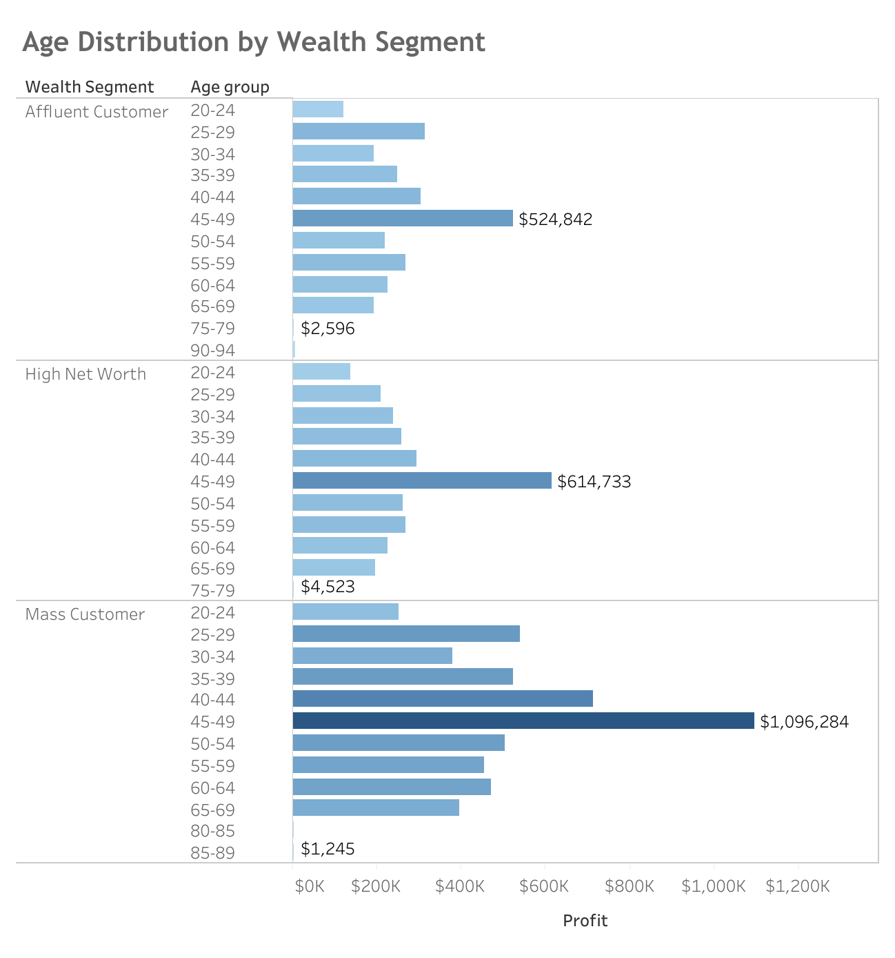
Note: The data and information in this document is reflective of a hypothetical situation and client. This document is to be used for KPMG Virtual Internship purposes only.
Data Exploration
Mass customers within the 45 – 49 age group generated the highest overall profit.
The Mass Customer segment consistently demonstrates higher profitability compared to other wealth segments across various age groups.
The 45 – 49 age group consistently generates higher profit compared to other age groups, followed by the 40 – 46 age group.
Customers aged between 75 - 94 across all wealth segments generate the lowest profit.

Slide 5
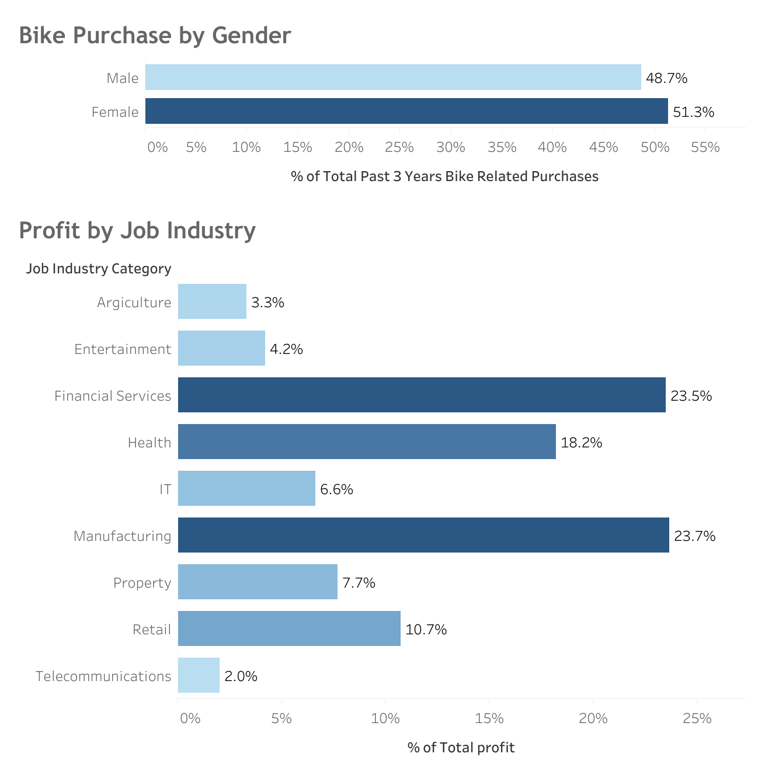
Note: The data and information in this document is reflective of a hypothetical situation and client. This document is to be used for KPMG Virtual Internship purposes only.
Data Exploration
Females account for 51.3% of the total bike-related purchases in the past 3 years, indicating their significant contribution to this category.
The top 3 job industries that generated the highest profit are Manufacturing Industry with 23.7% , Financial services Industry with 23.5% & Health Industry with 18.2%.
The Telecommunications industry generated the least profit, contributing only 2% to the total profit.

Slide 6
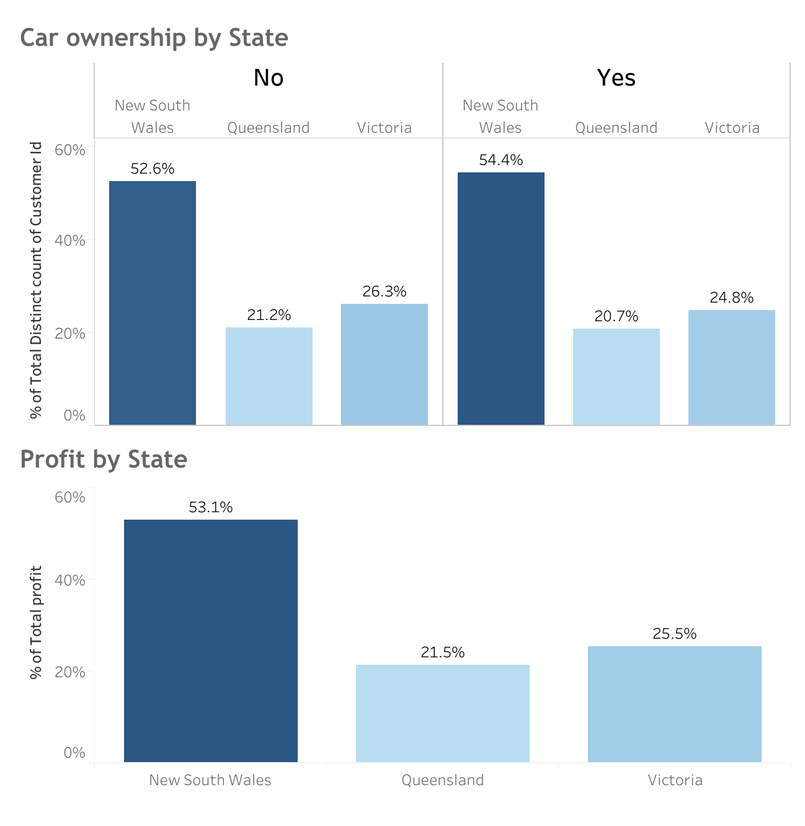
Note: The data and information in this document is reflective of a hypothetical situation and client. This document is to be used for KPMG Virtual Internship purposes only.
Data Exploration
52.6% of customers who do not own a car are located in New South Wales, indicating a higher potential for bike-related purchases in this region.
New South Wales generated the highest profit, accounting for 53.1% of the total profit generated.
Victoria contributed to 25.5% of the total profit, making it the second most profitable region.
Customers residing in New South Wales have shown higher profitability compared to other regions.

Slide 7
Note: The data and information in this document is reflective of a hypothetical situation and client. This document is to be used for KPMG Virtual Internship purposes only.
Model Development
CUSTOMER SEGMENTATION MODEL
Key Segments of High Value Customers to be Targeted are:
Age Group: Customers aged between 40 – 49.
Customer Segment: Mass customer group.
Geographic Location: Customers residing in New South wales.
Job Industry: Customers in the Manufacturing, Fiancial Services and Health Industries.
Gender: Both Male & Female.

Slide 8
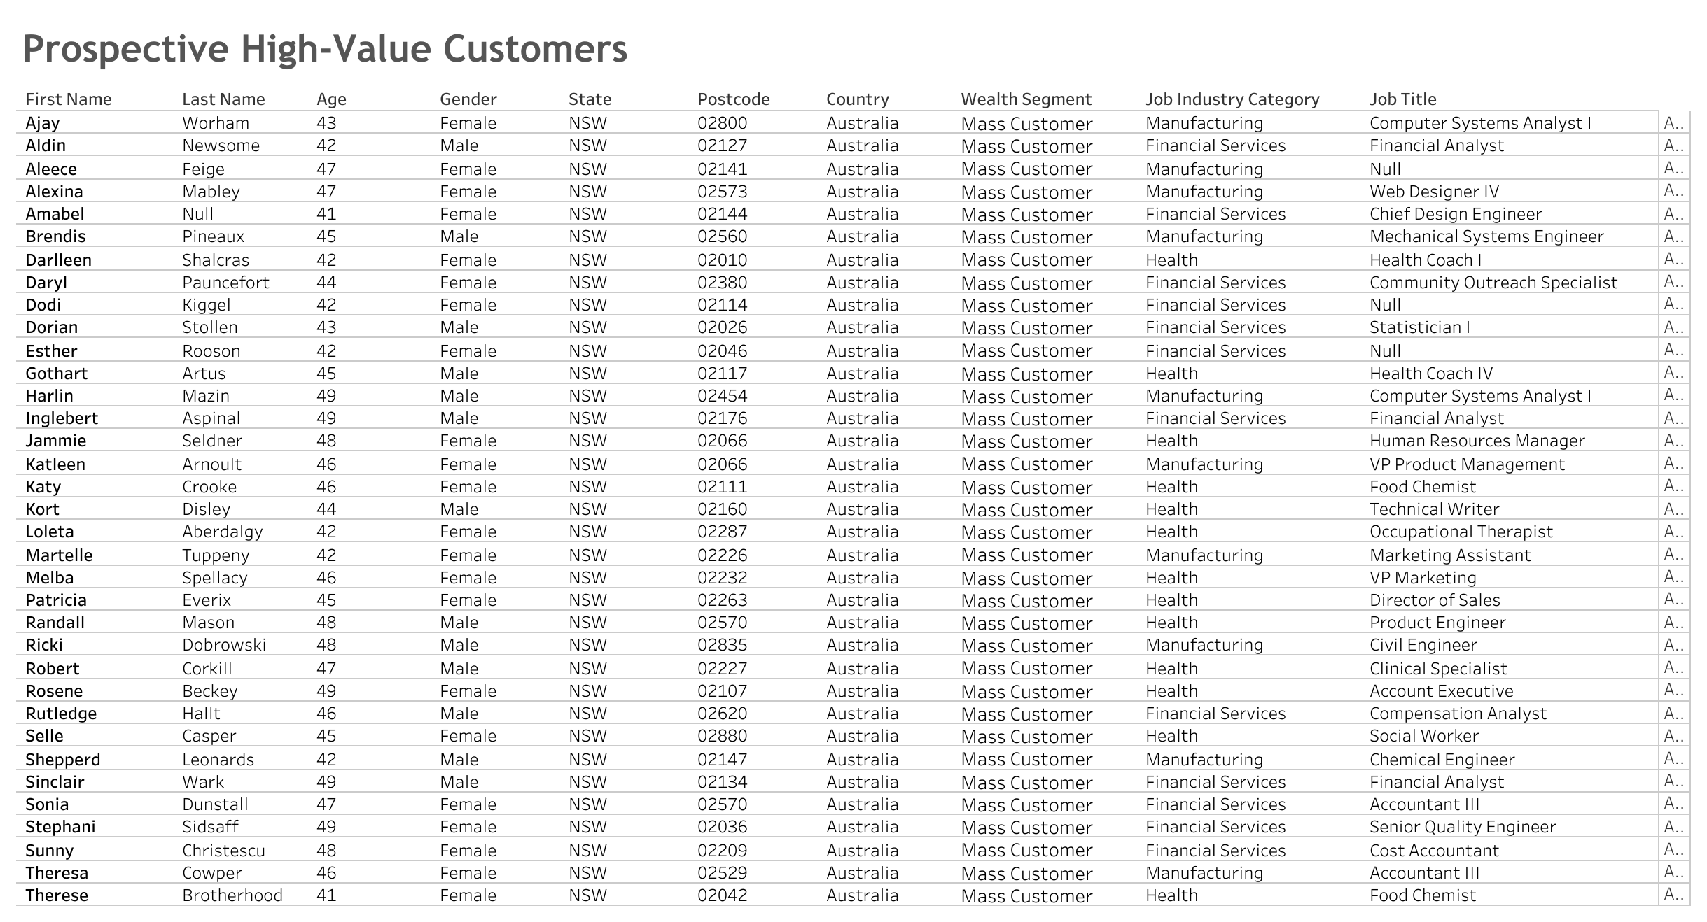
Note: The data and information in this document is reflective of a hypothetical situation and client. This document is to be used for KPMG Virtual Internship purposes only.
Interpretation

Slide 9
Note: The data and information in this document is reflective of a hypothetical situation and client. This document is to be used for KPMG Virtual Internship purposes only.
Thank You

